Slide 1

CS415: Databases

Slide 2
Lesson 1
Course Overview: Introduction to Databases and MySQL

Slide 3
Wholeness
This lecture focuses on giving an overview of what Databases are, by reviewing their history and the important role they play in a typical data-driven Software solution.
A Database is an organized, structured collection of data that is useful to an enterprise. Throughout this lesson, we will find that order is present everywhere; it is only our lack of understanding of the natural order of life that causes problems to arise.

Slide 4
Lesson 1 Objectives
Learn and understand the meanings of the terms – Data, Information, Database, Database Management system (DBMS).
Appreciate the importance of database systems and some of their common uses in real-world.
Appreciate the evolution and development of DBMSs and consider the various types (RDBMS e.g. MySQL versus Non-Relational DBs e.g. MongoDB).
Learn the typical functions of a DBMS.
Identify and understand the major components of the DBMS environment and the roles involved.
Examine the advantages of having DBMSs as well as some of their disadvantages/limitations.

Slide 5
1.1 Overview
Meaning of essentials terms:
Data: is facts or figures collected together through observation or measurement, for the purpose of referencing or analysis.
Information: is what is derived, when data has been made to become meaningful or useful through processing, interpreting or presenting.
Database: is a structured collection of related data.
Database Management system (DBMS): is software that manages and controls access to and operation of, a database.

Slide 6
1.1 Overview
Database Application: is any computer program that interacts with a database at some point during its execution.
Database system: is the collection of application programs that interact with the database, together with the DBMS and the database itself.
Note: All access to the Database is through the DBMS.

Slide 7
1.1 Overview
Why study Databases?
The Database system is perhaps the most important development in the field of software engineering.
A Database typically forms the underlying framework of the information system on which most organizations operate.
The importance of database systems keeps increasing, driven by significant developments in hardware capability/capacity and data communication and the emergence of the Internet, eCommerce, Business Intelligence and network/grid computing.

Slide 8
1.1 Overview
Some areas of application of Database systems:
Purchases from the supermarket.
Online purchases using your credit card.
Booking a vacation with a travel agency
Using the local/school library
Taking out insurance
Finding and watch a movie
Conducting online or traditional banking
Studying at a college or university
Using the Internet/World-wide websites

Slide 9
Main Point 1
It is important that we understand what Databases are, their usefulness within the context of an overall enterprise information system and the related terminologies surrounding the study of Database systems. Knowledge is different in different states of consciousness.

Slide 10
CS415: Databases

Slide 11
1.2 Evolution of Databases
To appreciate the history of Database systems, it is helpful to consider a short review of its predecessor – the File-based system – and the problems it had.
Traditional File-based system: was a system consisting of one or more application programs where-by each program defined and managed its own data.

Slide 12
1.2 Evolution of Databases
File-based system:
Were an early attempt at computerizing the manual filing system.
For example, an organization might have physical files set up to hold data relating to a project, product, task, client or employee etc.
The files are labeled and stored in one or more filing cabinets and with locks for security.
When some information is needed the user goes to the filing system & searches through.

Slide 13
1.2 Evolution of Databases
File-based system – a case study: DreamHome Rental Agency
DreamHome is a property rental agency that has two departments – Sales and Contracts.
The Sales department is responsible for the selling and renting of properties.
For example, whenever a client who wishes to offer his or her property as a rental
approaches the Sales Department, a form similar to the one shown in Figure 1.2(a)
is completed.

Slide 14
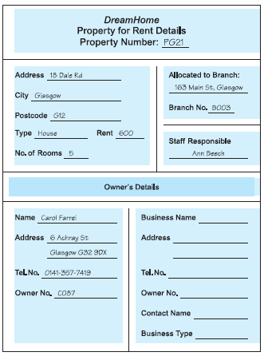
1.2 Evolution of Databases
File-based system – a case study: DreamHome Rental Agency
Fig 1.2a – Sales department: Property for rent details form

Slide 15
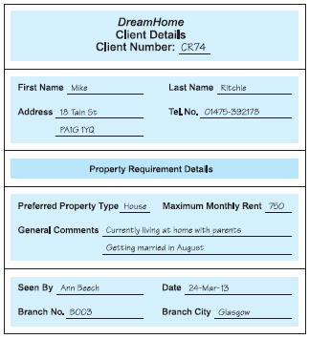
1.2 Evolution of Databases
File-based system – a case study: DreamHome Rental Agency
The Sales Department also handles inquiries from clients, and a form similar to the one shown in Figure l.2 (b) is completed for each one.
Fig 1.2b – Sales department: Client details form

Slide 16
1.2 Evolution of Databases
File-based system – a case study: DreamHome Rental Agency
The Sales department's File-based system will consists of three files containing property, owner, and client details, as illustrated in Figure 1.2c

Slide 17
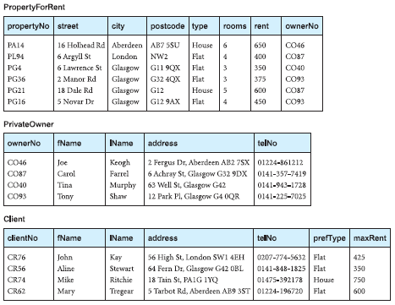
1.2 Evolution of Databases
File-based system – a case study: DreamHome Rental Agency
Fig. 1.2c – Sales department data files

Slide 18
1.2 Evolution of Databases
File-based system – a case study: DreamHome Rental Agency
DreamHome is a property rental agency that has two departments – Sales and Contracts.
The Contracts Department is responsible for handling the lease agreements associated with properties for rent. Whenever a client agrees to rent a property, a form with the client and property details is filled in by one of the sales staff, as shown in Figure 1.2d. This form is passed to the Contracts Department, which allocates a lease number and completes the payment and rental period details.

Slide 19
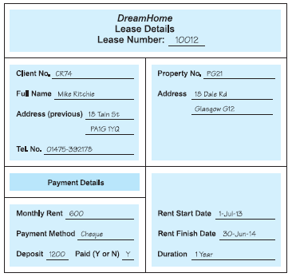
1.2 Evolution of Databases
File-based system – a case study: DreamHome Rental Agency
Fig 1.2d – Contracts department: Lease details form

Slide 20
1.2 Evolution of Databases
File-based system – a case study: DreamHome Rental Agency
The Contracts department’s file-based system will consists of three files that store lease, property, and client details, and that contain similar data to that held by the Sales Department, as illustrated in Figure 1.2e

Slide 21
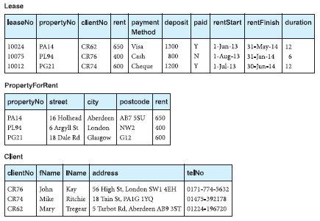
1.2 Evolution of Databases
File-based system – a case study: DreamHome Rental Agency
Fig. 1.2e – Contracts department data files

Slide 22
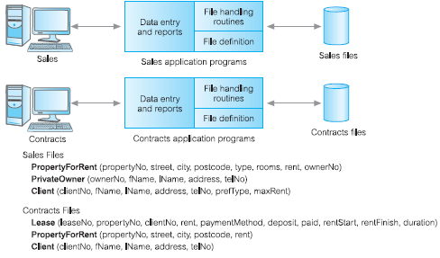
1.2 Evolution of Databases
File-based system – a case study: DreamHome Rental Agency
Fig. 1.2f – File-based processing system - shows each department accessing
their own files through application programs written especially for them. Each
set of departmental application programs handles data entry, file maintenance,
and the generation of a fixed set of specific reports. More important, the physical structure and storage of the data files and records are defined in the application code.

Slide 23
1.2 Evolution of Databases
File-based system – analysis
It can be seen quite clearly that there is a significant amount of duplication of data in these departments, and this is generally true of file-based systems.
To proceed in considering the limitations of this File-based approach, it may be useful to understand the terminology used in file-based systems.

Slide 24
1.2 Evolution of Databases
File-based system – analysis
A file is simply a collection of records, which contains logically related data.
For example, the PropertyForRent file in Figure 1.2c contains six records, one for each property. Each record contains a logically connected set of one or more fields, where each field represents some characteristic of the real-world object that is being modeled. In Figure 1.2c, the fields of the PropertyForRent file represent characteristics of properties, such as address, property type, and number of rooms.

Slide 25
1.2 Evolution of Databases
Limitations of File-based approach
Separation and Isolation of data.
When data is isolated in separate files, it is more difficult to access data that should be available.
For example, if we want to produce a list of all houses that match the requirements of clients, we first need to create a temporary file of those clients who have “house” as the preferred type. We then search the PropertyForRent file for those properties where the property type is “house” and the rent is less than the client’s maximum rent. With file systems, such processing is difficult. The application developer must synchronize the processing of two files to ensure that the correct data is extracted. This difficulty is compounded if we require data from more than two files.

Slide 26
1.2 Evolution of Databases
Limitations of File-based approach
Duplication of data.
Due to the decentralized approach taken by each department, the file-based
approach encouraged, if not necessitated, the uncontrolled duplication of data. For example, in Figure 1.2x we can clearly see that there is duplication of both property and client details in the Sales and Contracts Departments.
This results in waste, with higher cost in time and money for entering data more than once. And the unnecessary additional data storage space being required.

Slide 27
1.2 Evolution of Databases
Database approach
A Database and Database Management system offers a more effective solution to the above limitations posed by the traditional file-based systems.
A Database, more formally, can be defined as a shared collection of logically related data and its description, designed to meet the information needs of an organization.
It is a single, usually large repository of data that can be used by many departments and users

Slide 28
1.2 Evolution of Databases
Database approach
Instead of disconnected files with redundant data, all data items are integrated with a minimum amount of duplication.
The database is no longer owned by one department but is a shared corporate resource.
The database holds not only the organization’s operational data, but also a description of this data. For this reason, a database is also defined as a self-describing collection of integrated records. The description of the data is known as the system catalog (or data dictionary or metadata—the “data about data”). It is the self-describing nature of a database that provides program–data independence.

Slide 29
1.2 Evolution of Databases
Database approach
Question: What do we mean by, “logically related”?
To design and implement a computerized system for an organization, we first need to perform some Data analysis, where-by we analyze the data needs of the organization.
During this Data analysis task, we attempt to identify Entities, Attributes, and Relationships.
Notes:
Data analysis can sometimes be referred to as “Data modeling”

Slide 30
1.2 Evolution of Databases
Database approach
An Entity is a distinct object (a person, place, thing, concept, or event) in the organization that is to be represented in the database.
An Attribute is a property that describes some aspect of the object (entity) that we wish to record.
A relationship is an association between entities.
Notes:
Data analysis can sometimes be referred to as “Data modeling”

Slide 31
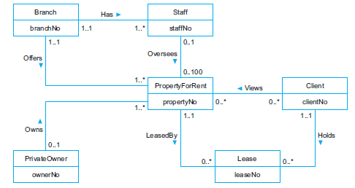
1.2 Evolution of Databases
Database approach
Figure 1.2g shows an Entity–Relationship (ER) diagram for part of the DreamHome case study.
Notes:
Data analysis can sometimes be referred to as “Data modeling”

Slide 32
1.2 Evolution of Databases
Database approach
The E-R diagram consists of:
six entities (the boxes/rectangles): Branch, Staff, PropertyForRent, Client, PrivateOwner, and Lease.
seven relationships (the names adjacent to the lines): Has, Offers, Oversees, Views, Owns, LeasedBy, and Holds.
six attributes, one for each entity: branchNo, staffNo, propertyNo, clientNo, ownerNo, and leaseNo.
Notes:
Data analysis can sometimes be referred to as “Data modeling”

Slide 33
1.2 Evolution of Databases
The Database
The database represents the entities, the attributes, and the logical relationships between the entities. In other words, the database holds data that is logically related.
We will examine/study the E-R diagrams and E-R modeling in further detail in Lesson 3.
Notes:
Data analysis can sometimes be referred to as “Data modeling”

Slide 34
1.2 Evolution of Databases
The Database Management system (DBMS)
The DBMS is the software that interacts with the users’ application programs and the database.
It is a software system that enables users to define, create, maintain, and control access to the database.
Notes:
Data analysis can sometimes be referred to as “Data modeling”

Slide 35
1.2 Evolution of Databases
Features of a Database Management system (DBMS)
It allows users to define the database and its constituent objects, usually through a Data Definition Language (DDL). The DDL allows users to specify the data types and structures and the constraints on the data to be stored in the database.
Notes:
Data analysis can sometimes be referred to as “Data modeling”

Slide 36
1.2 Evolution of Databases
Features of a Database Management system (DBMS)
It allows users to insert, update, delete, and retrieve data from the database, usually through a Data Manipulation Language (DML). Having a central repository for all data and data descriptions allows the DML to provide a general inquiry facility to this data, called a query language.
The most common query language is the Structured Query Language (SQL, pronounced “S-Q-L”, or sometimes “See-Quel”), which is now both the formal and de-facto standard language for relational DBMSs. We study SQL in Lesson 2.
Notes:
Data analysis can sometimes be referred to as “Data modeling”

Slide 37
1.2 Evolution of Databases
Features of a Database Management system (DBMS)
It provides controlled access to the database; which includes:
a security system, which prevents unauthorized users accessing the database.
an integrity system, which maintains the consistency of stored data.
a concurrency control system, which allows shared access of the database.
a recovery control system, which restores the database to a previous consistent state following a hardware or software failure.
Notes:
Data analysis can sometimes be referred to as “Data modeling”

Slide 38
1.2 Evolution of Databases
Features of a Database Management system (DBMS)
It provides controlled access to the database; which includes:
a user-accessible catalog (aka the database schema or data dictionary), which contains descriptions of the data in the database.
Notes:
Data analysis can sometimes be referred to as “Data modeling”

Slide 39
1.2 Evolution of Databases
Database Application Program
Is a computer program that interacts with the database by issuing an appropriate request (typically an SQL statement) to the DBMS.
Users interact with the database through a number of application programs that are used to create and maintain the database and to generate information.
Application programs can be command line interface app, Desktop GUI app, a batch application or an online/web app.
Notes:
Data analysis can sometimes be referred to as “Data modeling”

Slide 40
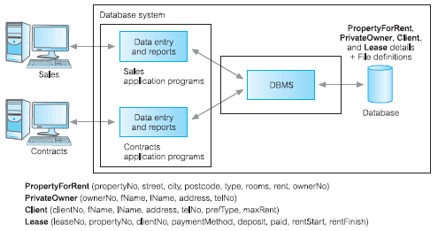
1.2 Evolution of Databases
Fig 1.2h – the Database approach applied to the DreamHome case study
Notes:
Data analysis can sometimes be referred to as “Data modeling”

Slide 41
Main Point 2
Database systems have evolved over the years, changing from traditional File-based systems to what is the predominant technology today, the Database Management systems (DBMSs). The Nature of life is to grow!

Slide 42
CS415: Databases

Slide 43

1.3 Components of the DBMS Environment
The following 5 major components can be identified in the DBMS environment:
Hardware
Software
Data
Procedures
People

Slide 44
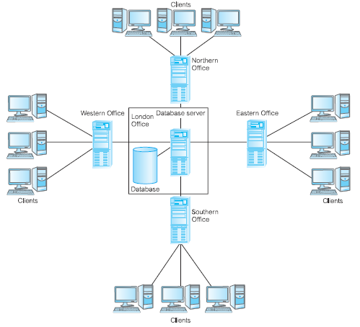
1.3 Components of the DBMS Environment
Hardware: the DBMS require hardware to run. This can be a single personal computer or a large Mainframe computer or a network of servers.

Slide 45
1.3 Components of the DBMS Environment
Software: The software component comprises the DBMS software itself and the application programs, together with the operating system, including network software if the DBMS is being used over a network.
Data: This is quite easily the most important component of the DBMS, from the end-users’ point of view
the data acts as a bridge between the machine components and the human components.
The database contains both the operational data and the metadata, the “data about the data”.

Slide 46
1.3 Components of the DBMS Environment
Data:
The structure of the database is called the schema.
For example, in Figure 1.2h, the schema consists of four files, or tables, namely: PropertyForRent, PrivateOwner, Client, and Lease.
The PropertyForRent table has eight fields, or attributes, namely: propertyNo, street, city, zipCode, type (the property type), rooms (the number of rooms), rent (the monthly rent), and ownerNo.
The ownerNo attribute models the relationship between PropertyForRent and PrivateOwner: that is, an owner Owns a property for rent, as depicted in the ER diagram of Figure 1.2g. For example, in Figure 1.2c we observe that owner CO46, Joe Keogh, owns property PA14.

Slide 47
1.3 Components of the DBMS Environment
Procedures: This refers to the instructions and rules that govern the design and use of the database. The users of the system and the staff who manage the database require documented procedures on how to use or run the system. These may consist of instructions on how to:
Log on to the DBMS
Use a particular DBMS facility or application program
Start and stop the DBMS
Make backup copies of the database
Handle hardware or software failures
People: This means the people or roles involved with the Database system; which will be the next topic in Section 1.4

Slide 48
1.4 Roles in the Database Environment
Four (4) distinct types of people (roles) who participate in a DBMS environment, can be identified:
Data and Database Administrators (Das & DBAs): Responsible for management and control of the DBMS and its data
Database designers: These has the Logical Database designers (identify data entities, attributes and constrains – business rules) and the Physical Database designers (plans and decides how the Logical DB is to be physically implemented)
Application Developers: Responsible for developing the application programs which will make use of the Database.
End-users: these are the users of the database, whose information needs are to be served.

Slide 49
1.5 Advantages and disadvantages of DBMSs
Advantages:
Control of data redundancy.
Greater guarantee of Data consistency.
Access to more information for the same amount of data
Sharing of data
Improved data integrity
Improved security
Lower cost of building and maintaining enterprise information systems
Notes:
Data analysis can sometimes be referred to as “Data modeling”

Slide 50
1.5 Advantages and disadvantages of DBMSs
Disadvantages:
Complexity
Need for larger size of storage resources
Cost of DBMSs
Additional hardware cost
Cost of converting from non-DBMS to DBMS
Some Performance degradation
Greater impact of failure*
* It depends on the architecture. Can be avoided.
Notes:
Data analysis can sometimes be referred to as “Data modeling”

Slide 51
1.6 Data Models and Conceptual Modeling
A model is a representation of real-world objects and events, and their associations.
A Data model is an integrated collection of concepts for describing and manipulating data, relationships between data, and constraints on the data in an organization.
A Conceptual data model is one that is used to represent the logical view of an organization’s data, which is DBMS-independent.
Two of the broad categories of data models that exist are: Object-based and Physical model.

Slide 52
1.6 Data Models and Conceptual Modeling
Object-based data model is used to describe data at the conceptual level
Object-based data models use concepts such as entities, attributes, and relationships.
An entity is a distinct object (a person, place, thing, concept, event) in the organization that is to be represented in the database.
An attribute is a property that describes some aspect of the object that we wish to record.
A relationship is an association between entities.
An example of an Object-based data model is the Entity-Relationship (ER) model

Slide 53
1.6 Data Models and Conceptual Modeling
The Entity-Relationship (ER) model has emerged as one of the main techniques for database design and forms the basis for the database design methodology we study in this course.
Conceptual modeling or conceptual database design is the process of constructing a model of the information use in an enterprise that is independent of implementation details, such as the target DBMS, application programs, programming languages, or any other physical considerations. This model is called a conceptual data model.

Slide 54
1.7 Functions of a DBMS
A typical DBMS can be expected to provide the following functions and services:
Data storage, retrieval and update capabilities
A User-accessible catalog
Transaction support: Most DBMSs will ensure ACID properties in their transaction management capabilities (A: Atomicity, C: Consistency, I: Isolation, D: Durability)
Concurrency control services: multiuser support with various locking mechanisms to ensure data integrity and consistency
Recovery services
Authorization services
Support for data communication
Integrity services

Slide 55
1.7 Functions of a DBMS
A typical DBMS can be expected to provide the following functions and services:
Services to promote data independence
Utility services – most DBMSs provide a set of utility programs and tools for the DBAs and AppDevs

Slide 56
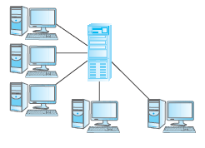
1.8 Database Application Architectures
Multi-user DBMS Architectures:
Teleprocessing
This was the traditional architecture for multi-user systems, where there
is one computer with a single central processing unit (CPU) and a number of dumb terminals

Slide 57
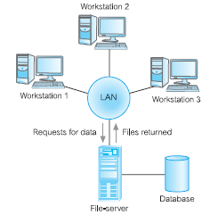
1.8 Database Application Architectures
Multi-user DBMS Architectures:
File-Server Architecture
In this architecture, the processing is distributed about the network (LAN). The file-server holds the files required by the applications and the DBMS. However, the applications and the DBMS run on each workstation, requesting files from the file-server when necessary

Slide 58
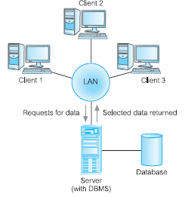
1.8 Database Application Architectures
Multi-user DBMS Architectures:
Traditional 2-tier Client-Server
Architecture
Client–server refers to the way in which software components interact to
form a system.
There is a client process, which requires some resource, and a server, which provides the resource. There is no requirement that the client and server must reside on the same machine.

Slide 59
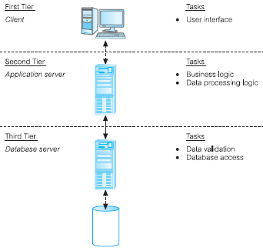
1.8 Database Application Architectures
Multi-user DBMS Architectures:
3-tier Client-Server
Architecture
This architecture proposed three layers, each potentially running on a different platform:
The user interface layer, which runs on the end-user’s computer (the client).
The business logic and data processing layer. This middle tier runs on a server and is often called the application server.
A DBMS, which stores the data required by the middle tier. This tier may run
on a separate server called the database server.

Slide 60
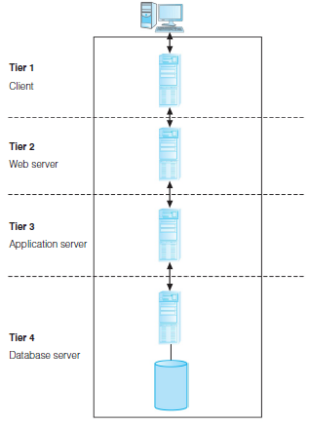
1.8 Database Application Architectures
Multi-user DBMS Architectures:
N-tier Client-Server
Architecture
The three-tier architecture can be expanded to n tiers, with additional tiers providing more flexibility and scalability.
The middle tier of the architecture could be split into two, with one tier for the Web server and another tier for the application server. In environments with a high volume of throughput, the single Web server could be replaced by a set of Web servers (or a Web farm) to achieve efficient load balancing.

Slide 61
1.9 Cloud Computing and Cloud-hosted Databases
Cloud computing is the term given to the use of multiple servers over a digital network (such as the Internet) as if they were one computer.
It is a model for enabling ubiquitous, convenient, on-demand network access to a shared pool of configurable computing resources (e.g., networks, servers, storage, applications, and services) that can be rapidly provisioned and released with minimal management effort or service provider interaction.
The following 3 service models are exist:
Infrastructure as a Service (IaaS)
Platform as a Service (PaaS)
Software as a Service (SaaS)

Slide 62
1.9 Cloud Computing and Cloud-hosted Databases
Cloud-based Database Solutions: As a type of SaaS, cloud-based database solutions fall into two basic categories: Data as a Service (DaaS) and Database as a Service (DBaaS):
Daas offers the ability to define data in the cloud and subsequently query that data on demand. Unlike traditional database solutions, DaaS does not implement typical DBMS interfaces such as SQL. Instead, the data is accessed via a common set of APIs. e.g. Urban Mapping, a geography data service.
DBaaS offers full database functionality to application developers.

Slide 63
1.9 Cloud Computing and Cloud-hosted Databases
Cloud-based Database Solutions: As a type of SaaS, cloud-based database solutions fall into two basic categories: Data as a Service (DaaS) and Database as a Service (DBaaS):
In DBaaS, a management layer is responsible for the continuous monitoring and configuring of the database to achieve optimized scaling, high availability, multi-tenancy (that is, serving multiple client organizations), and effective resource allocation in the cloud, thereby sparing the application developer from ongoing database administration tasks. Examples include: Amazon's RDS, Google's BigQuery, Microsoft Azure DB etc.

Slide 64
Main Point 3
DBMS environment has 5 major components: Hardware, Software, Data, Procedures and People.
Database Application architecture are typically structured in layers/tiers which demonstrates that ‘Life is found in layers’, and that ‘lower layers have more power’.

Slide 65
CS415: Databases

Slide 66
1.10 Introduction to MySQL
MySQL is an open-source relational database management system (RDBMS)
In this course we will be studying and implementing the various Database Management system concepts and techniques using a MySQL instance
Therefore, you are required to download and install a MySQL Database server on your local machine (if you do not already have it).*
MySQL can be obtained from https://dev.mysql.com/
*Note: A demonstration of how to obtain and install MySQL will be given.

Slide 67
CS415: Databases

Slide 68
Conclusion
This lesson 1 has given you an overview of the Databases and Database Management systems.
You should now be sufficiently familiar with general idea of what a Database is. Your understanding of these will guide the rest of our studies throughout the remainder of this course.
The subsequent lessons will explore these topics in greater detail.

Slide 69
Connecting the Parts of Knowledge With the Wholeness of Knowledge
Overview and Introduction of Databases and DBMSs
1. A Database is a shared collection of logically related data and its description, designed to meet the information needs of an organization
2. Database Management system (DBMS) is a software system that enables users to define, create, maintain, and control access to the database.
___________________________________________________________
3. Transcendental consciousness is the underlying basis of all levels of creation.
4. Impulses within the Transcendental Field: The well-designed Database which forms the basis of an elegant software solution, arises as an impulse of the Transcendental Field.
5. Wholeness moving within itself: In Unity Consciousness, one directly perceives that all expressions and levels of creation are nothing more than one’s own Self – pure consciousness.

Slide 70
CS418: Databases & Software Development

